Slide 1
Aquila District Roundtable
November 13, 2024

Slide 2
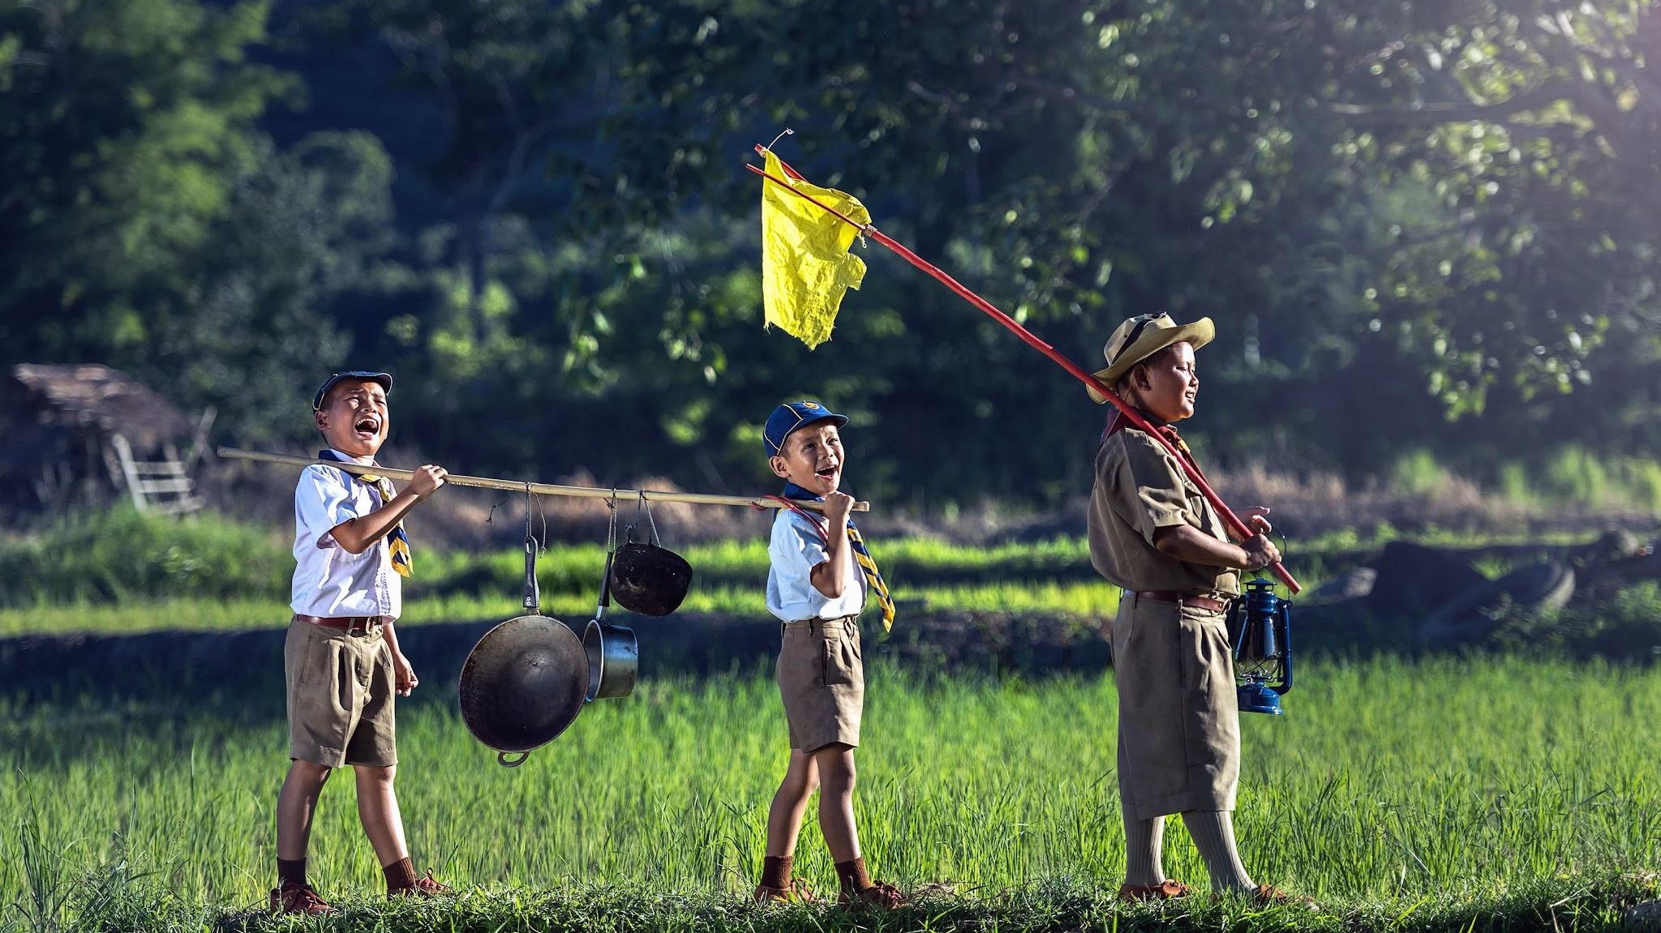
Welcome to Roundtable

Slide 3
Agenda
Opening
Announcements
Fun Time
Member and Unit Renewal Presentation
Q&A

Slide 4
Invocation
Dear God, we ask for your blessings upon all the scouts around the world who strive to live by the values of scouting. Guide them on their journeys of learning and growth, and help them to develop their skills, leadership, and character. May they always be prepared to serve their communities, and may they find joy and fulfillment in their scouting adventures. Grant them safety and protection, and may they always be surrounded by good and faithful friends. Amen.

Slide 5
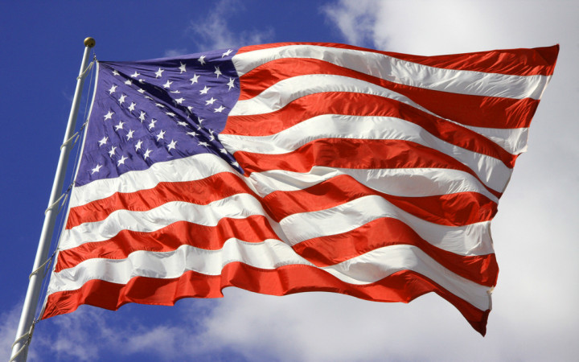
Pledge
Oath
Law
Code

Slide 6
Announcements

Slide 7
Upcoming Event Highlights
December Roundtable Party and Potluck Dec 11th 7:30pm @ St Tom
National Youth Leadership Training Jan 3-5 and 10-12 @ Workcoeman
Aquila Winter Western Camporee (Klondike) Jan 24-26th
Aquila District Dinner Mar 12th

Slide 8
Connie’s Corner
Fire Ban 🔥🔥🔥
Suicide Prevention
Popcorn Sales Requirement Conversation

Slide 9
New Eagles

Slide 10
Fun Time

Slide 11
Class B Raffle
Group chat the event or unit of the Class B you are wearing along with the year you got it
Randomly selected entry will win a 2 for 1 ticket to the Aquila District Dinner

Slide 12
Trivia Raffle
Private chat your answer to Gregg Baimel
Randomly selected entry will win a 2 for 1 ticket to the Aquila District Dinner

Slide 13
Trivia Questions
Scouts BSA - Why do Scouts BSA scouts shake with their left hand?

Slide 14
Renewal
Recharter
What’s different?
What’s not?

Slide 15
Recharter is now
Member and Unit Renewal
The Diff

Slide 16
Recharter Member and Unit Renewal
Member Renewal
12-month rolling basis
Based on initial member joining date
Separate from Unit Renewal
Council fees included, unit dues are not
Three payment/process options
Auto
Manual
Unit Paid
Unit Renewal
Annual Process
Complete before January 1
Separate from Member Renewal
Wet signature on Charter Agreement
Two payment/process options
Online
At Council

Slide 17
Member Renewal Payment/Process Options
No prorations or refunds after Member Renewal - collect dues BEFORE member renewal!
No more Recharter Day! Member Renewals occurs through the year, not all at once.
90-day email alert to member and Key 3 of upcoming Member Renewal
60-day email alert and window to renew before renewal date
60-day grace period after renewal date before membership is cancelled and online renewal no longer possible - paper application will be required

Slide 18
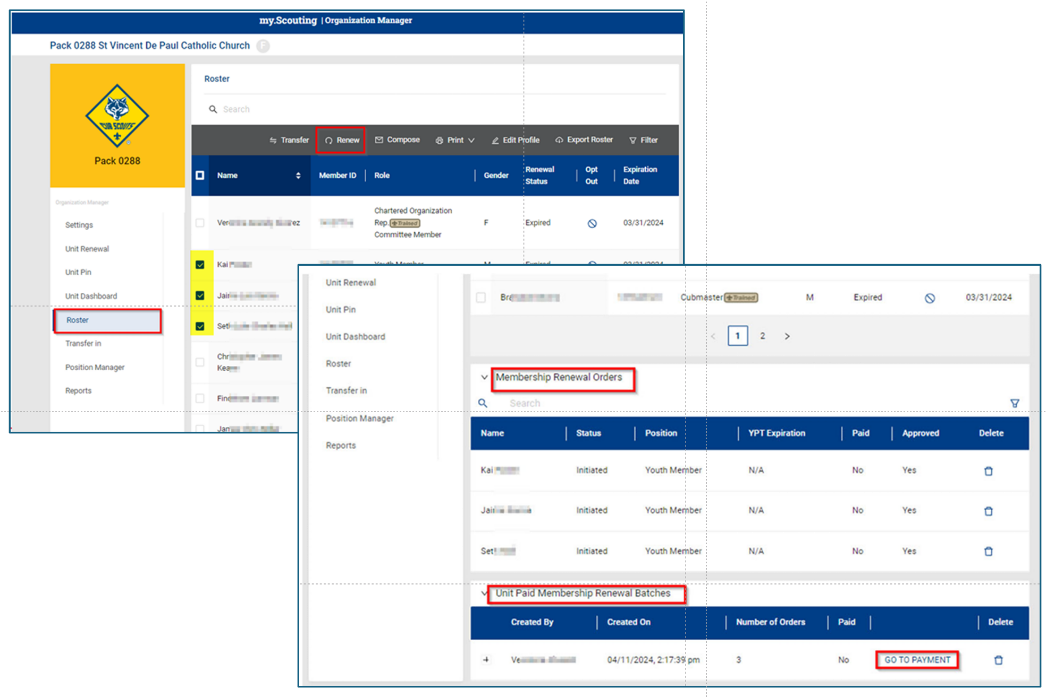
Select Roster, Select Members to Renew
Member Renewals
Roster

Slide 19
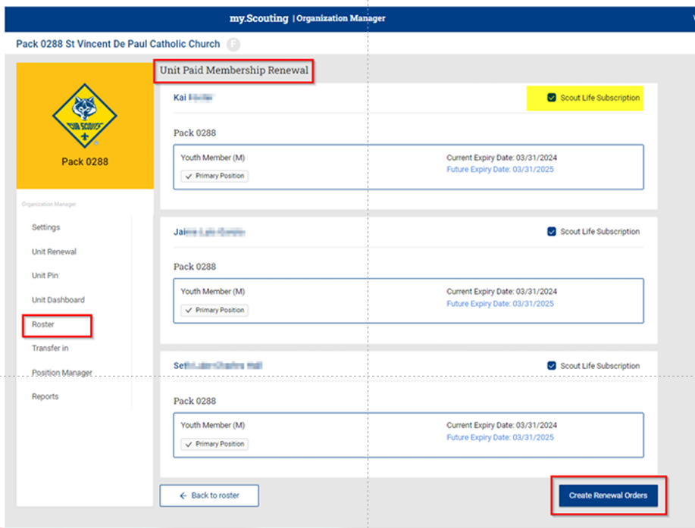
Complete Renewal Order or Pay
Member Renewals
Roster

Slide 20
Prep for Unit Renewal
The Same

Slide 21
Assign A Unit Renewal Coordinator
Must be a Key 3 or Delegate in my.scouting.org
Should NOT be unit leader, preferably a membership chair or unit renewal coordinator

Slide 22
Conduct Membership Inventory
Confirm returning adults and youth
Confirm any adults and youth not continuing
Confirm any adult leader position changes (better during summer)
Submit all new membership applications as members join pamela.sugrue@scouting.org

Slide 23
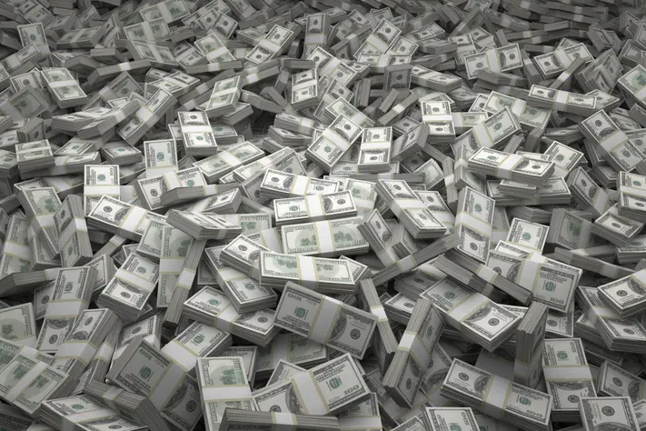
Collect Dues
Any hardship cases, please contact us

Slide 24
Complete YPT in 2024
Adult members whose YPT expires in 2025 will NOT be registered

Slide 25
Ensure all adult leaders complete position
specific training
Training records available in my.scouting.org
All registered leaders required to complete training for their positions
Hazardous weather training required for all direct contact leaders
Minimum leaders to renew: COR, CC, SM or CM, 2 Committee Members, 1 Den Leader if a pack

Slide 26
Meet with Unit Commissioner to complete JTE
Scorecards available at https://www.scouting.org/awards/journey-to-excellence/
Hold Key 3 (COR, CC, SM or CM) Meeting with Unit Commissioner to discuss progress toward goals and reflect on improvements

Slide 27
Complete Online
Unit Renewal
Key 3 selects “Unit Renewal” on unit dash in my.scouting.org
Validation
Unit does not have required number of leadership positions
Leaders do not have current YPT
Leaders are less than 18 years old
Leaders do not have completed CBC Authorizations
Adults do not have SSN
Digitally sign, Pay

Slide 28
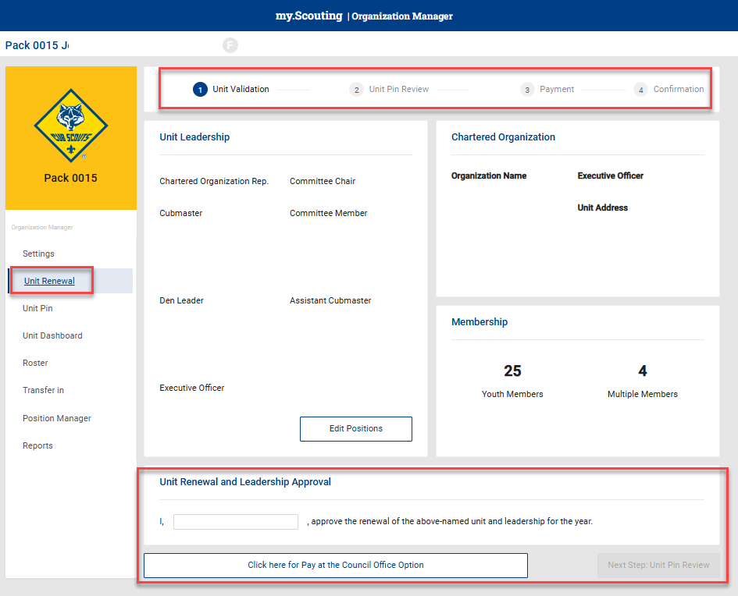
Click on Unit Renewal
Unit Renewal
Button

Slide 29
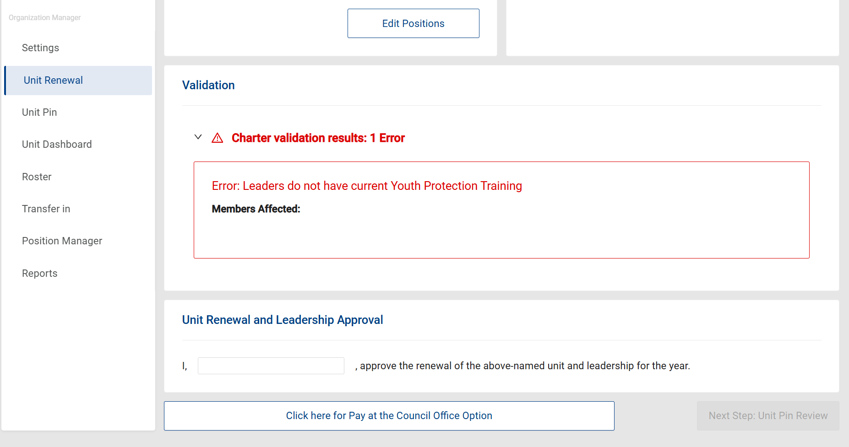
Validation

Slide 30
Digital Signature and Payment

Slide 31
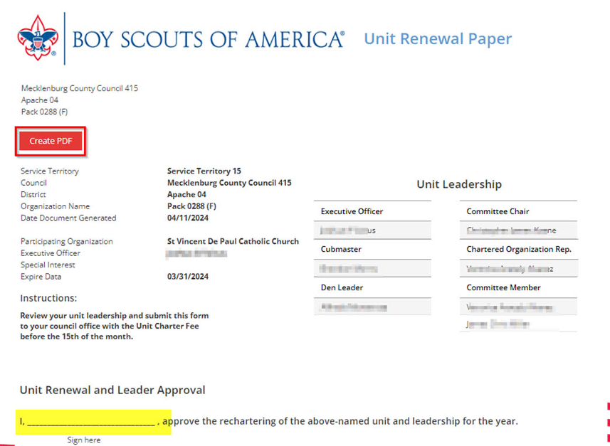
Unit Renewal Paper for Council Payment

Slide 32
All done

Slide 33
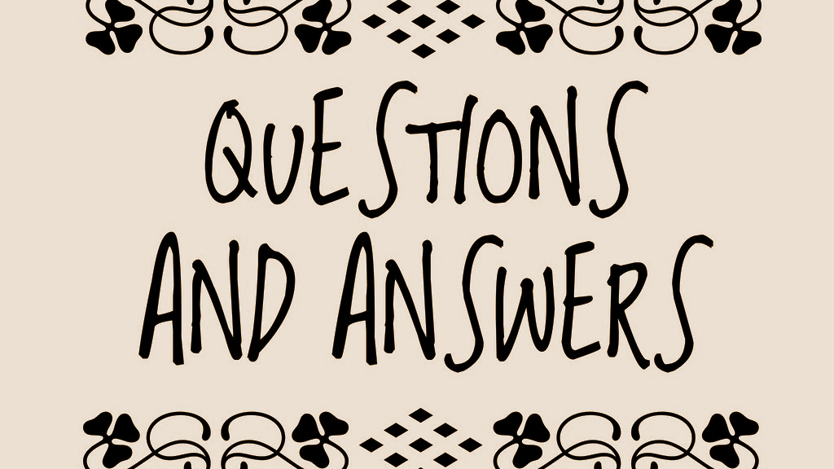

Slide 34
Trivia Answer
Scouts BSA - Why do Scouts BSA scouts shake with their left hand?
The left hand is closer to the heart. Or, while Lord baden-powell was in West Africa, he met with Ashanti chiefs who offered their left hands and said, "In our land only the bravest of the brave shake hands with the left hand, because to do so we must drop our shields and our protection." So, as Scouts we shake with the left hand to symbolize our trust for one another and to remind us to be brave.

Slide 35
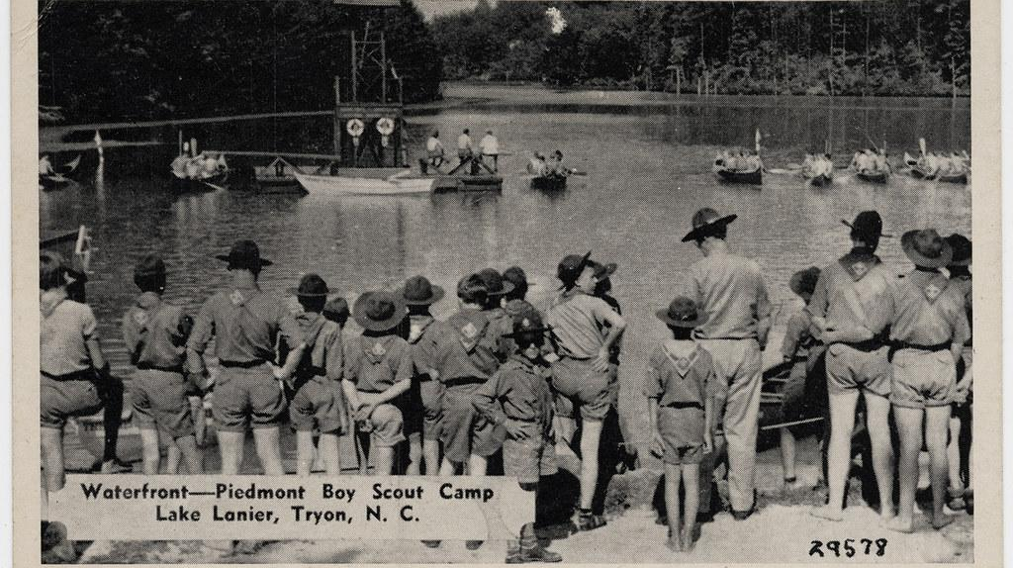
Mission Moment

Slide 36
Benediction
May the Great Master of all scouts watch between me and thee while we are apart one from another.
Be Prepared..
WE ARE!

